Slide 1
File I/O
CSE-105
Structured Programming Language

Slide 2
File Operations
File handle : FILE *
Open a file : fopen
Input/Output
  Character IO : getc, putc
  String IO : fgets, fputs
  Formatted IO : fscanf, fprintf
  Raw IO : fread, fwrite
Close a file : fclose
Other operations :
  fflush, fseek, freopen

Slide 3
File Manipulation Concepts
fopen
fread, getc, fgets, fscanf
buffer
This a is line
Option 32
129430
And more
Text here
CPU
test.txt
This a is line
Option 32
129430
And more
Text here
New text added
New text added
ffush,
fclose
fwrite, putc, fputs, fprintf
RAM
Hard Disk Drive
Note: CPU access is through some temporary variable (in RAM) in your code.

Slide 4
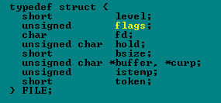
File Handle

Slide 5
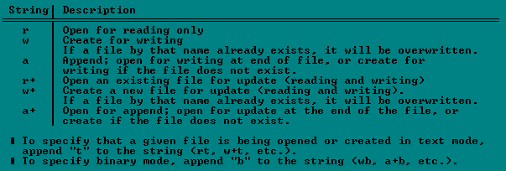
Opening a file
FILE *fopen(char *name, *mode);

Slide 6
Character IO : getc, putc
int getc(FILE *stream);
  getc returns the next character on the given input stream and increments the stream's file pointer to point to the next character.
  returns the character read, after converting it to an int without sign extension.
int putc(int c, FILE *stream);
  putc outputs the character given by c to the stream given by stream.
  returns the character given by c.
On error (and on end-of-file for getc), both functions return EOF.

Slide 7
Example: getc, putc
/* filecopy: copy file ifile, to file ofile */
void filecopy(char *ifile, char *ofile) {
FILE *ifp = fopen(ifile, “r”);
FILE *ofp = fopen(ofile, “w”);
int c;
while ((c = getc(ifp)) != EOF)
putc(c, ofp);
}
See code in page 162.

Slide 8
Formatted IO : fscanf, fprintf
int fprintf(FILE *stream, const char *format, argument, ...);
  Just like printf.
  Return
    ON SUCCESS: number of bytes sent to output
    ON FAILURE: returns EOF
int fscanf (FILE *stream, const char *format, address, ...);
  Just like scanf.
  Return
    ON SUCCESS: Number of scanned inputs.
    ON FAILURE: fscanf returns EOF.

Slide 9
Raw IO : fread, fwrite
size_t fread(void *ptr, size_t size, size_t n, FILE *stream);
  fread reads a specified number of equal-sized data items from an input stream into a block.
Argument│ What It Is/Does
════════╪═══════════════════════════════════════════
ptr │ Points to a block into which data is read
size │ Length of each item read, in bytes
n │ Number of items read
stream │ Points to input stream
  The total number of bytes read is (n * size).
  Return Value:
    ON SUCCESS: returns the number of items (not bytes) actually read
    On FAILURE: returns a short count (possibly 0)

Slide 10
Raw IO : fread, fwrite
size_t fwrite(void *ptr, size_t size, size_t n, FILE *stream);
  fwrite appends a specified number of equal-sized data items to an output file.
    Argument│ What It Is/Does
    ════════╪════════════════════════════════════════════
    ptr │ Pointer to any object; the data written
    │ begins at ptr
    size │ Length of each item of data
    n │ Number of data items to be appended
    stream │ Specifies output file
  The total number of bytes written is (n * size).
  Return Value:
    ON SUCCESS: returns the number of items (not bytes) actually written
    On FAILURE: returns a short count (possibly 0)

Slide 11
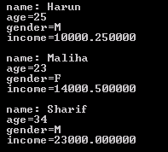
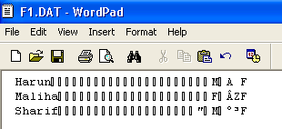
Raw IO: Example
struct info {
char name[25];
int age;
char gender;
float income;
};
int main(void)
{
struct info a[] = {
{"Harun", 25, 'M', 10000.25 },
{"Maliha", 23, 'F', 14000.50 },
{"Sharif", 34, 'M', 23000 }
};
struct info b[3];
FILE *fp = fopen("f1.dat", "w");
fwrite(a, sizeof(struct info), 3, fp);
fclose(fp);
fp = fopen("f1.dat", "r");
fread(b, sizeof(struct info), 3, fp);
for (int i = 0; i < 3; i++)
printf("\n name: %s\n age=%d\n gender=%c\n income=%f\n",
b[i].name, b[i].age, b[i].gender, b[i].income);
fclose(fp);
return 0;
}

Slide 12
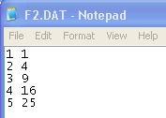

Redirecting I/O : freopen
FILE *freopen(const char *filename, const char *mode, FILE *stream);
freopen("f2.dat", "w", stdout);
for (int i = 1; i <= 5; i++)
printf("%d %d\n", i, i*i);
fclose(stdout);
freopen("f2.dat", "r", stdin);
while (scanf("%d %d", &a, &b)==2)
printf("%d %d\n", a, b);
fclose(stdin);
Note:
Be careful while redirecting strings. printf does not append a \0 when printing %s.
Numbers are stored as string in f2.dat. But numbers are in raw format in f1.dat

Slide 13
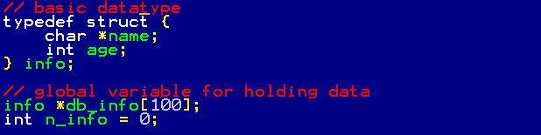
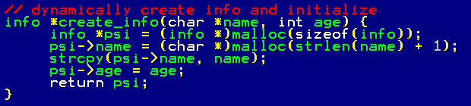

Pointer in struct: Create

Slide 14
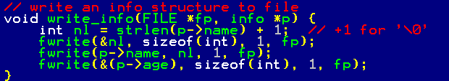

Pointer in struct: Write to File

Slide 15
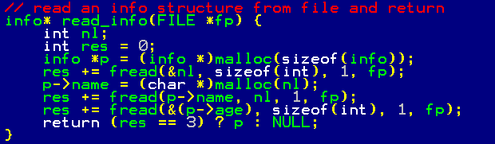
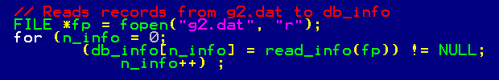
Pointer in struct: Read from File

Slide 16



Pointer in struct: Use and Release
Look into strctio2.cpp

